Slide 1
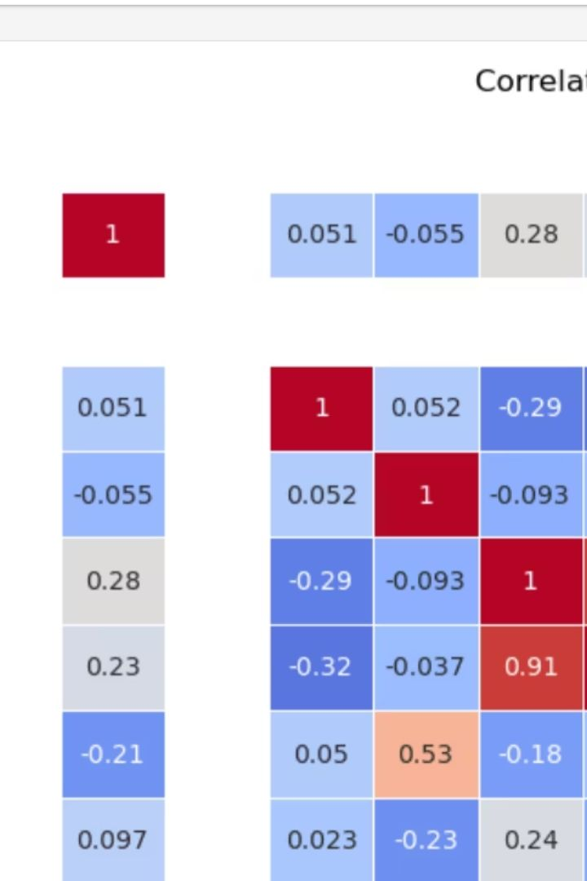
Data Wragling using Pandas
Presented by: Shivangi Chaudhary,
Company Name-Nexthikes IT Solutions

Slide 2
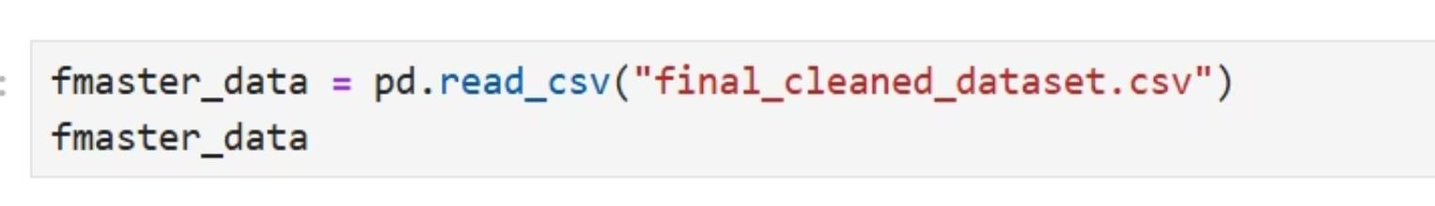
Getting Started: Pandas & CSV Import
Key Libraries
Loading Data
Pandas is fundamental for data handling.
Using Jupyter notebook, Import CSV files effortlessly using pd.read_csv(). Specify the file path directly.
Pandas for data structures
NumPy for numerical computing
Simple file upload
seaborn, matplotlib
Direct path specification
(adding snippet of how we load csv file)

Slide 3
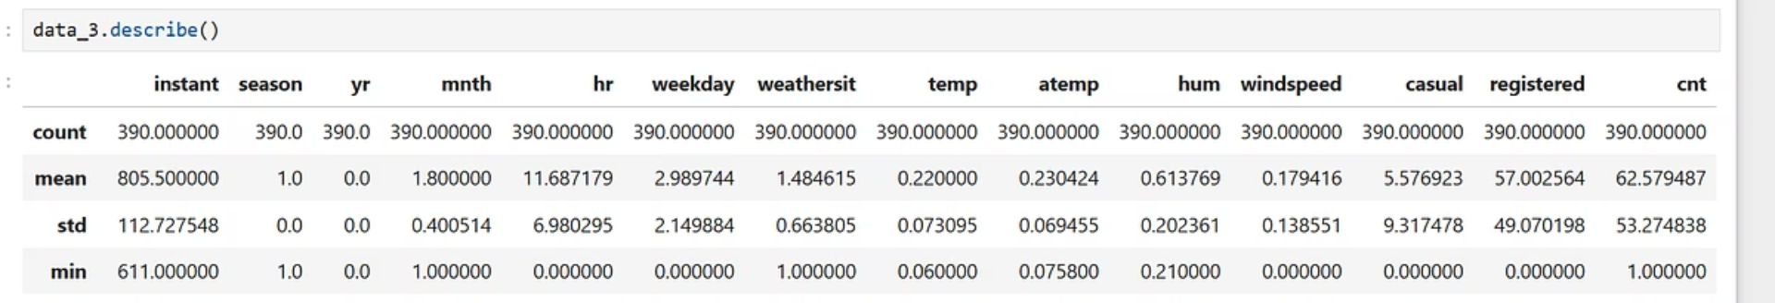
Dataset Preprocessing Essentials
Correct Dtypes & Drop Columns
Remove Duplicates
Handle Missing Data
Clean your dataset by eliminating duplicate rows. .drop_duplicates() is your tool.
Summarize & Inspect
Ensure columns have correct data types. Remove any unnecessary columns for analysis.
Identify and remove or impute null values. Use .dropna() or .fillna() strategically.
Use .info() and .describe() for quick overviews. Understand data types and distributions.
Effective preprocessing ensures data quality and prepares your dataset for accurate analysis.

Slide 4


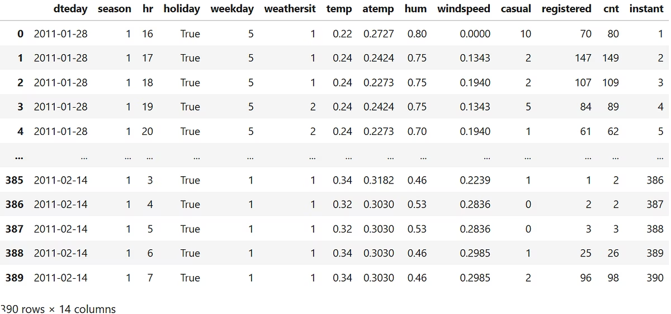


Merging Datasets for Unified Analysis
Identify Common Keys
Find shared columns across datasets.
Choose Merge Type
Select 'inner', 'outer', 'left', or 'right' joins.
Here, I used inner merge.
Execute Merge
Use pd.merge() for combining DataFrames.
In our project, we perform merging two times.
(Adding snippet of final data after merge)

Slide 5
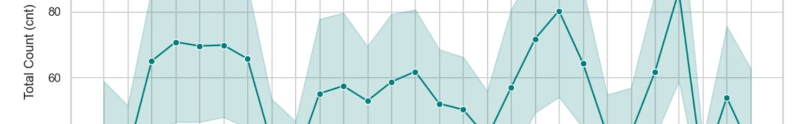
Basic Exploratory Data Analysis (EDA)
Line Graphs
Bar Charts
Insight:
Visualize trends over time. Ideal for sequential data exploration.
Compare categorical data effectively. Display distributions and counts.
Reveals trends, anomalies, distribution patterns.
Show temporal patterns
Categorical comparisons
Identify sequential changes
Frequency distributions
Plot time series: sns.lineplot(x='date', y='sales')
Plot categories: sns.barplot(x='category', y='count')
EDA helps uncover initial patterns, anomalies, and relationships within your data, forming hypotheses for further investigation.
I have used, line and bar graph to understand the dataset for dataset_1,dataset_2,dataset_3 and dataset_A.(adding snippet)

Slide 6








Advanced EDA: Outliers & Correlations
Outlier Detection
Outlier Handling
Identify data points far from typical values. Use box plots or statistical methods.
Decide whether to remove, transform, or cap outliers. Context matters.
Scatter Plots
Seaborn Heatmaps
Explore relationships between two continuous variables. Reveal clusters or trends.
Visualize correlations between variables. Quickly spot strong relationships.
Advanced EDA provides deeper insights, improving model performance and understanding complex data structures.

Slide 7
Navigating Challenges and how to overcome
New to advanced Pandas coding
Challenge: Unfamiliar with functions like merge()
Solution: Used mentor-provided references and documentation; practiced using examples from Real Python, GeeksforGeeks, and Pandas docs.
Limited EDA and heatmap skills
Challenge: Struggled with creating Seaborn heatmaps and plots
Solution: Learned through YouTube tutorials (e.g., Seaborn heatmap basics and customization)
Data with duplicate columns (X and Y versions)
Challenge: Final dataset had redundant X and Y columns making it hard to manage
Solution: Wrote custom Pandas code to streamline columns (e.g., dynamic renaming or consolidation); searched online (Google & YouTube).
References-
Python Merge Tutorial
User guide and tutorial — seaborn 0.13.2 documentation
Pandas Tutorial (Data Analysis In Python)
Master Exploratory Data Analysis (EDA) in Python: Step-by-Step Jupyter Notebook Tutorial

Slide 8
Thank You!
Thank you for your attention. We hope this presentation offered valuable insights into leveraging Pandas for powerful data analysis. Please feel free to ask any questions.
(Also, the images that I have used in this ppt are from snippets from my projects.)

